Slide 1
PROFIT, LOSS AND DISCOUNT

Slide 2
LEARNING OUTCOMES
By the end of this lesson students will be able to :
Define cost price, selling price, profit, loss, profit%, loss%, marked price, discount, successive discount, goods and services tax.
calculate profit and loss.
Solve problems related to profit% and loss%.
calculate discount .
calculate goods and services tax.

Slide 3
HISTORY
The first profit and loss statement could be traced back to the time where barter system was used. The small vendors could remember or wrote on a diary of their daily profit or loss.
As trade between people grew many stake holders got involved in business and it became more complex together with the introduction of money in the form of coin.

Slide 4
INTRODUCTION
Suppose your friend gives you Rs 150 for a pencil box that you got for Rs 125. You sell it to him and then buy a pen from him for Rs250. Later you find out that the pen was worth Rs200 .
Did you lose money or did you make a profit?

Slide 5
When you do a business transaction like selling things if you earn some amount in the transaction that amount is called the profit
and
If you lose some amount then it is called loss.

Slide 6
COST PRICE: The amount paid to purchase an article or the price at which an article is made is known as its COST PRICE (C.P.)
SELLING PRICE : The price at which an article is sold is known as its SELLING PRICE (S.P.)

Slide 7
PROFIT
If the selling price of an article is greater than the cost price, then the difference between the selling price and cost price is called profit /gain.
S.P > C.P. ⇨ PROFIT
PROFIT = S.P. – C.P.
SELLING PRICE = C.P. + PROFIT
COST PRICE = S.P. - PROFIT

Slide 8
Q. By selling an article for Rs 450, a person gains Rs 50. What will be the profit, if it is sold for Rs 500?
Ans: Selling price = Rs 450
Profit = Rs 50
Cost price = S.P. – Gain
= Rs(450 - 50)
= Rs 400
Again selling price = Rs500
Profit = S.P. – C.P.
=Rs(500 - 400)
=Rs100.

Slide 9
PROFIT %
The profit per cent is the profit that would be obtained for a cost price of Rs100.
PROFIT % =

Slide 10
Q A man bought a cycle for Rs. 250. For how much should he sell it so as to gain 10%?
Ans: Cost Price = Rs250
Gain =10%
Gain amount = 10% of Rs250
=Rs
=Rs 25
Selling Price = C.P. + gain = Rs(250+25) = Rs 275

Slide 11
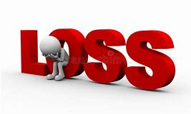
LOSS
If the cost price of an article is greater than the selling price, then the difference between the cost price and selling price is called LOSS.
C.P. > S.P. ⇨ LOSS
LOSS = C.P. – S.P.
SELLING PRICE = C.P. - LOSS
COST PRICE = S.P. + LOSS

Slide 12
LOSS %
The loss per cent is the loss that would be obtained for a cost price of Rs100.
LOSS % =

Slide 13
Q. By selling 42 oranges, a person loses a sum equal to selling price of 8 oranges. Find the loss percent.
Ans: Let the S.P. of 1 orange = Rs 1
S.P. of 12 oranges = Rs1 12 = Rs12
Loss = S.P. of 8 oranges = Rs1 8 = Rs8
So, C.P. of 42 oranges = S.P. + Loss
= Rs (42 + 8) =Rs 50
Loss% = = = 16%

Slide 14
TO FIND S.P./C.P. WHEN C.P./S.P. AND PROFIT % GIVEN
PROFIT % =
=

Slide 15
Q. By selling a table for Rs 600 , a man earns a profit of 12% . How much did it cost the shopkeeper?
Ans: S.P. of the table = Rs 600
Profit = 12%
Cost price of the table =
=Rs 500

Slide 16
TO FIND S.P./C.P. WHEN C.P./S.P. AND LOSS % GIVEN
LOSS % =

Slide 17
Q . Ram sold an article to Gopal at 10% profit and Gopal sold it to Atul for Rs 440 at a loss of 20%. Find original price of the article.
Ans: For Gopal,
S.P. of the article = Rs 440
Loss % = 20 %
Hence, C.P. of the article= = =Rs 550.
For Ram,
S.P. of the article = Rs 550
Profit = 10%
Hence, its original price = = =Rs500.
So, original price of the article was Rs 500.

Slide 19
DISCOUNT
To attract the customers, the shopkeeper offers certain schemes and rebates in order to increase the sale or clear the old stock.
A rebate which is offered by the shopkeeper on the price of an article is called a discount.
Discount is usually given as a percentage of the original price.

Slide 20
The price which is written on an article is called MARKED PRICE(M.P.) or LIST PRICE(L.P.)
The price at which an article is sold is called its SELLING PRICE(S.P.)
Selling Price = M.P. – Discount
Marked Price = S.P. + Discount
Discount = M.P. – S.P.
Discount % =

Slide 21
Q Natasha offers her customers a discount of 10% on her beauty products and she still makes a profit of 20%. What is the actual cost to her of that beauty product marked Rs. 400?
Marked price = Rs. 400 Discount = 10% Profit = 20% Therefore, the Selling Price = 90% of 400 Therefore 400 x 90/100 = Rs. 360 Selling price = Rs. 360 Profit = 20% Cost price = 100/120 x 360 = Rs. 300

Slide 22
TO FIND S.P./M.P WHEN M.P./S.P and DISCOUNT % GIVEN

Slide 23
Q. At what price should an object be marked to make a profit of 20% on its purchase price 80 after being discounted by 20%?
Solution:
Here, CP = 80.
SP = 20% increase (profit) on 80 (CP),
Therefore, SP = (120/100) × 80 = 96
Now, SP = 80% of MP, because of 20% discount on MP.
Therefore, SP = (80/100) × MP
i.e. 96 = (80/100) × MP
MP = 96 × (100/80) = 120

Slide 24
Successive Discount
Successive discount is the discount offered on the discount.
The formula for total discount in case of successive discounts : If the first discount is x% and 2nd discount is y% then , Total discount = ( x + y - xy / 100 ) %

Slide 25
Q. The successive-discount of 10% and 20% are given on the purchase of a bag . If the price of the bag is Rs 2250, find the selling price.
Solution: As the successive discount is 10% and 20% Total discount = ( x + y - xy / 100 ) % x = 10% and y = 20% Total discount = [ 10 + 20 – ( 10 x 20) / 100] % = ( 30 – 200 /100 ) % Total discount = 28% Discount = 28% of 2250 Discount = ( 28 / 100 ) x 2250 Discount = Rs630 S.P = M.P – Discount = 2250 – 630 Selling price = Rs 1620

Slide 26
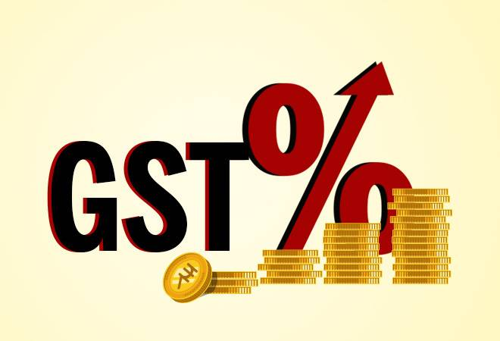
GOODS AND SERVICES TAX(GST)
GST is an indirect tax applicable throughout India which has replaced multiple taxes levied by the central and state governments.
GST comprises
Central GST(CGST) – levied by centre.
State GST (SGST) – levied by state.
Integrated GST(IGST) – levied by centre on inter-state supply of goods and service.
GST is charge on cost price of an article.
Amount of GST = $\frac{GST \%}{100}$ X CP

Slide 27
Q. Rahim purchased a water bottle at Rs 330 including 10% GST. Find the price of the water bottle before GST was added.
Ans: Price of the water bottle including
GST =Rs 330
GST = 10%
Let the price before GST was added = Rsx
A.t.q, x+$\frac{X}{10}$=330
$\frac{11X}{10}$=330
x =300
So, the price of the water bottle before GST added was Rs300.

Slide 28
ACTIVITY
Based on Profit and loss per cent:
Collect the names of 5 grocery items.
Collect the cost price and selling price of the items.
Prepare a chart of profit/ loss per cent on each item.

Slide 29
MIND MAPPING
FDDFBV
PROFIT & LOSS
C.P<S.P
C.P >S.P
PROFIT
C.P = S.P
LOSS
NO GAIN NO LOSS

Slide 30
KEY TAKEAWAY
The amount paid to purchase an article is called its C.P.
The price at which an article is sold is known as its SELLING PRICE
S.P > C.P.⇨ PROFIT
C.P.> S.P. ⇨LOSS
Profit % and Loss% always calculated on cost price.
Price marked on an article is called MARKED PRICE
A certain percentage of rebate on the marked price of an article is called DISCOUNT.
GST is an indirect tax used in India on the supply of goods and services.
GST is charged on cost price of an article and it is added to the cost price of the article.

